Slide 1
Installing programs for Python coding
Yeungnam University
South Korea

Slide 2
Content
Programming languages
Why python
Anaconda
Google Colab
PyCharm

Slide 3
Programming languages
Python (around 80% of developers)
Java (3 billion devices)
Javascript
NodeJS
Ruby
PHP
Golang
Rust
Elixir
Kotlin
TypeScript
C
C+
C++
C#
RStudio
Source: https://blog.back4app.com/top-10-python-alternatives/
https://www.geeksforgeeks.org/top-10-programming-languages-to-learn-in-2022/

Slide 4
Why python?
Open source
User friendly
Easy to learn
Widely used with IoT Technology
Large community : can share your problem and learn together
Python is flexible : Multi-purpose programming language
Well suited to data science and analytics

Slide 5
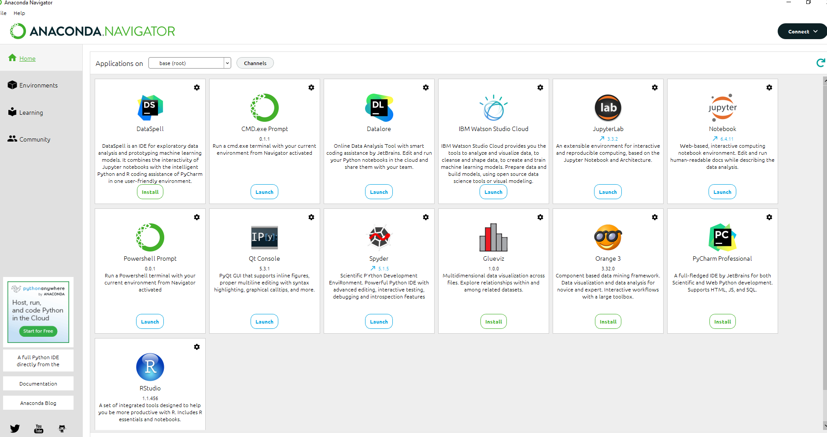
Anaconda
Official page: https://www.anaconda.com/products/distribution#windows
It is free and open-source.
It has more than 1500 Python/R data science packages.
Anaconda simplifies package management and deployment.
It has tools to easily collect data from sources using machine learning and AI.
https://docs.anaconda.com/anaconda/install/windows/

Slide 6
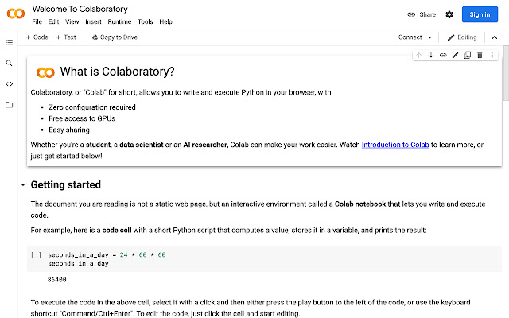
Google Colab
Colaboratory, or “Colab” for short, is a product from Google Research.
Colab is a hosted Jupyter notebook service
Colab is free of charge to use
Site: https://colab.research.google.com/
Faq site: https://research.google.com/colaboratory/faq.html

Slide 7
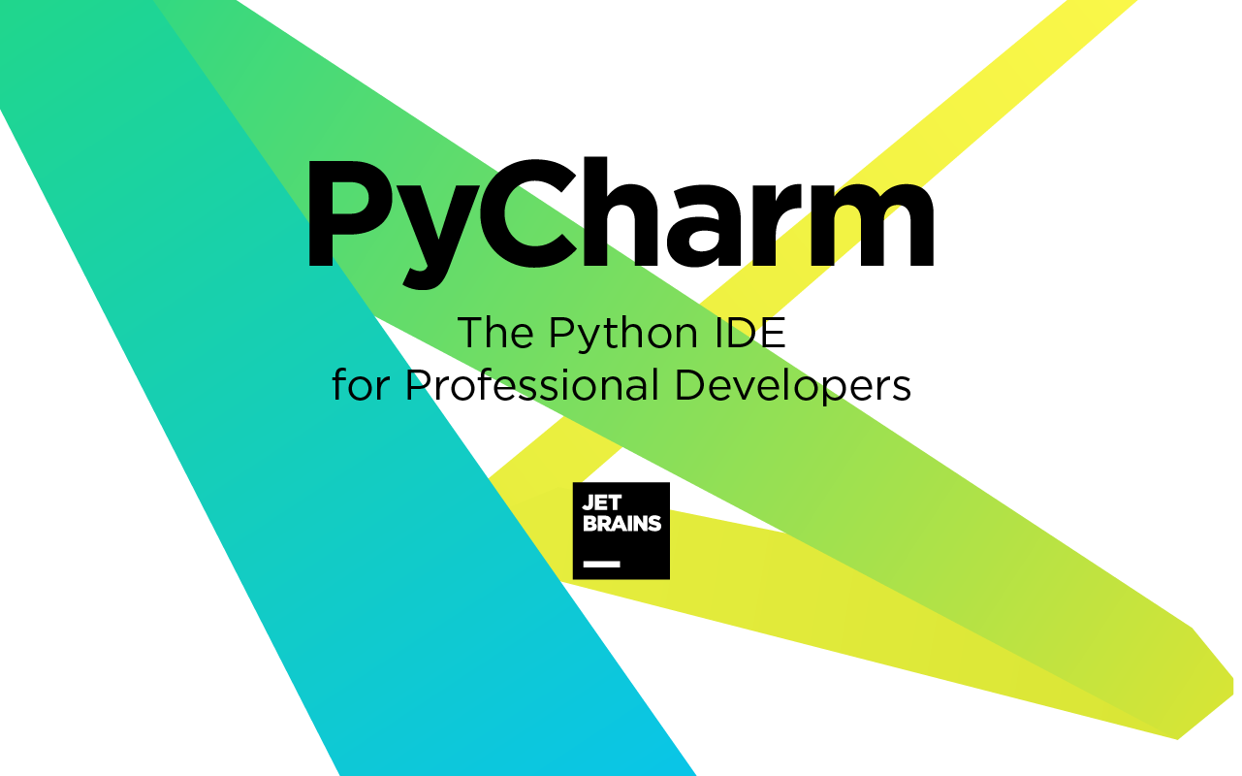
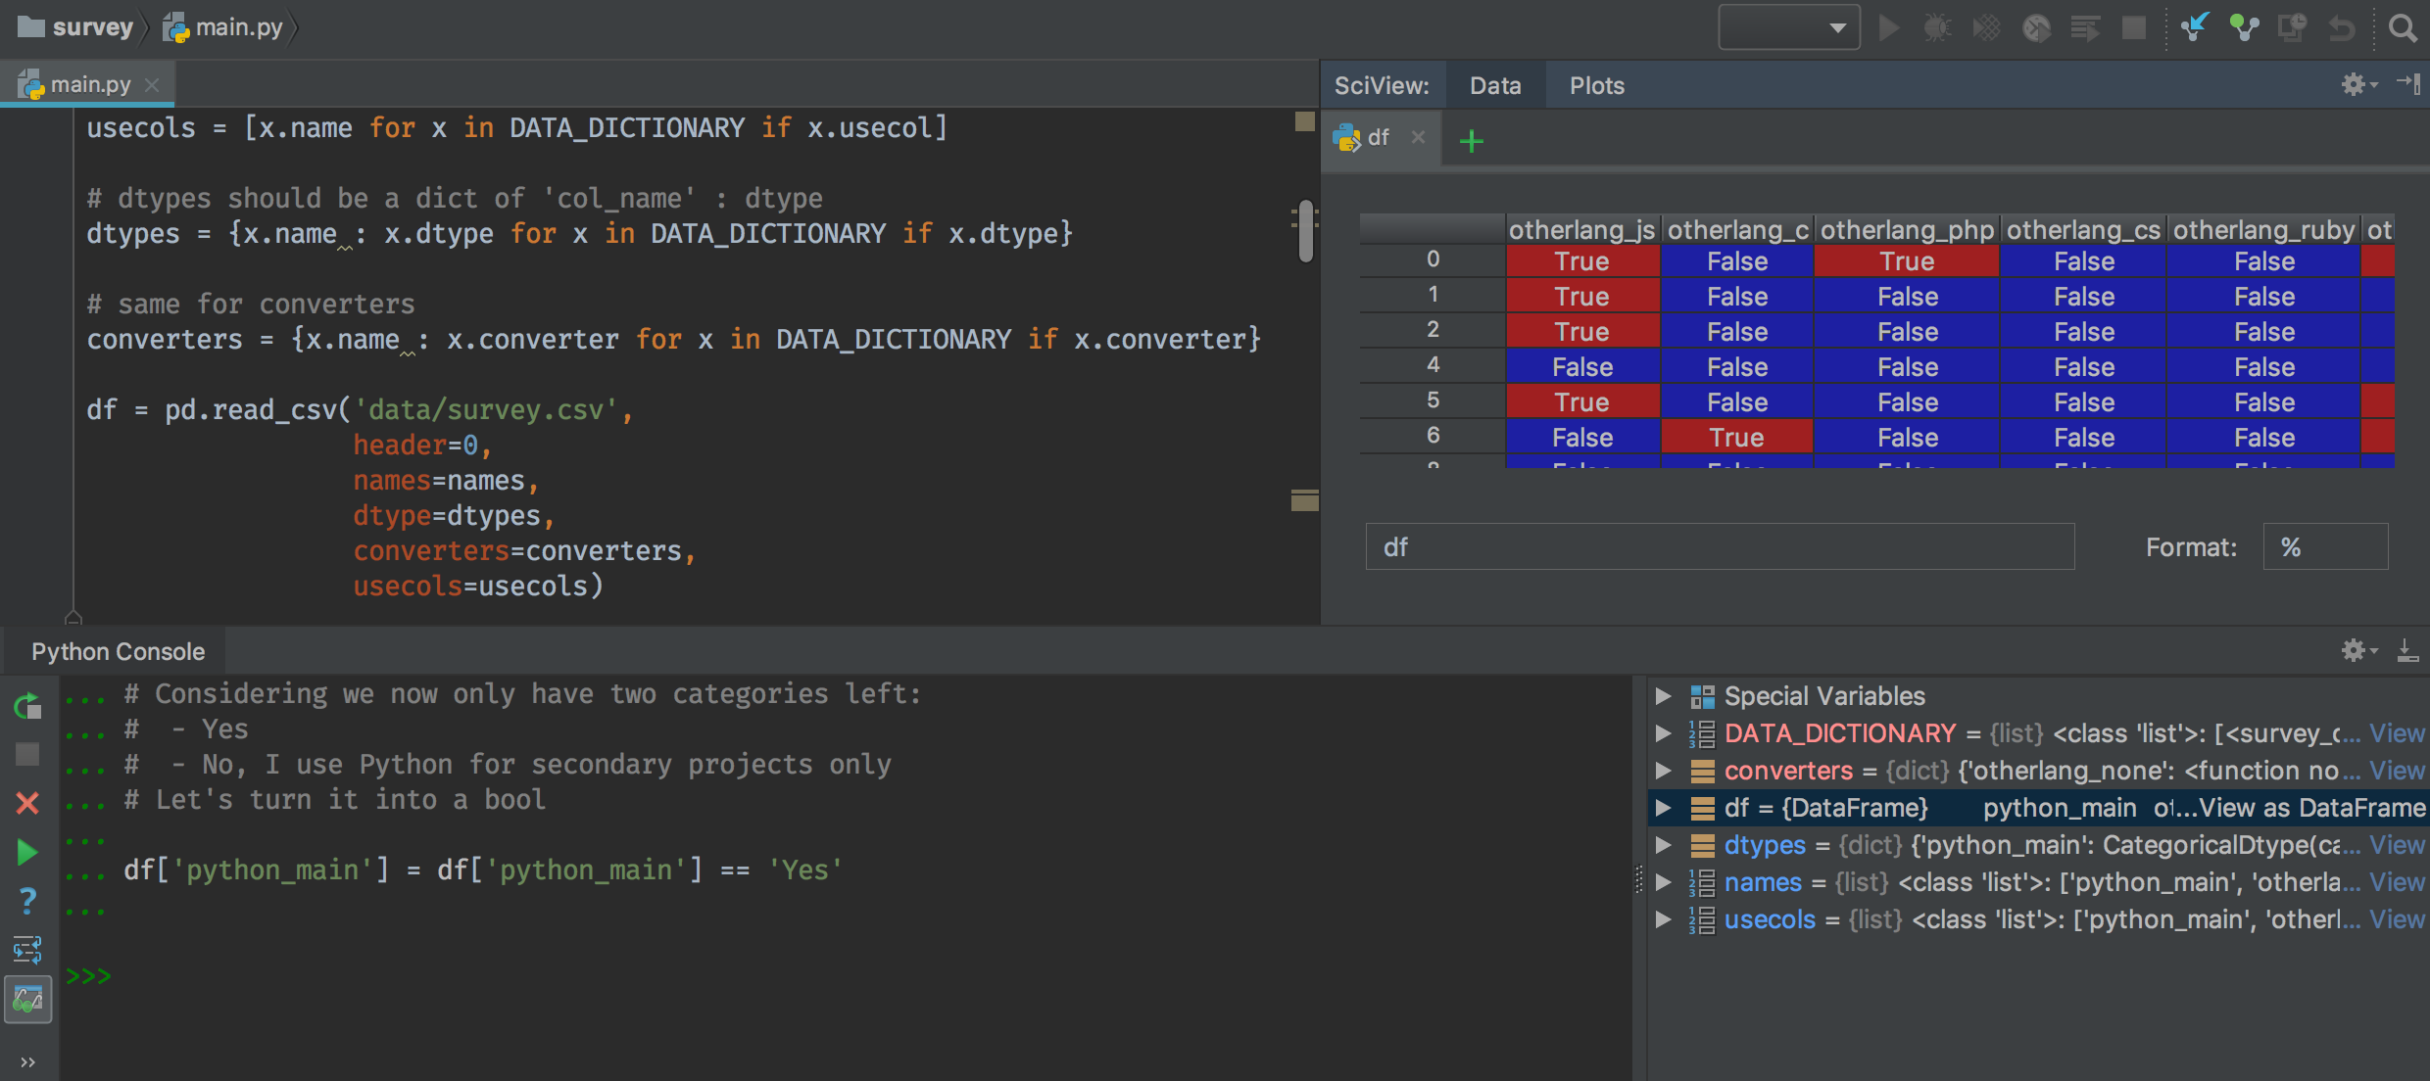
PyCharm
https://www.jetbrains.com/pycharm/
Python IDE for professional developers
Intelligent Coding Assistance. PyCharm provides smart code completion, code inspections, on-the-fly error highlighting and quick-fixes, along with automated code refactorings and rich navigation capabilities.
Built-in Developer Tools.
Web Development.
Scientific Tools

Slide 8
Working directory in Jupiter notebook
Current working directory
pwd or
import os
os.getcwd()
Change directory
import os
os.chdir('C:/Users/IT/Desktop/Data_science/example')

